Slide 1


CUSTOMER ATTRITION ANALYSIS FOR RETAIL SHOPPERS
Analysis of Fiscal Year 2018-2019 Data

Slide 2
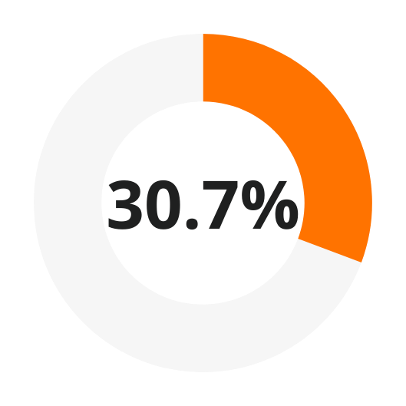
Objective of the Analysis
Analyze factors leading to customer attrition using retail shopper data.
Develop actionable insights to identify and reduce attrition risk.
Dataset Overview:
Total Customers: 99,702
Attrited Customers: 30,622
Attrition Rate: 30.71%
CUSTOMER POPULATION ATTRITION RATE

Slide 3
Key Features Analyzed
Variables investigated for their role in predicting attrition:
Baskets: Frequency of transactions.
Units: Number of items purchased.
Sales: Spending amount.
Days Since Last Purchase: Recency of customer activity.

Slide 4
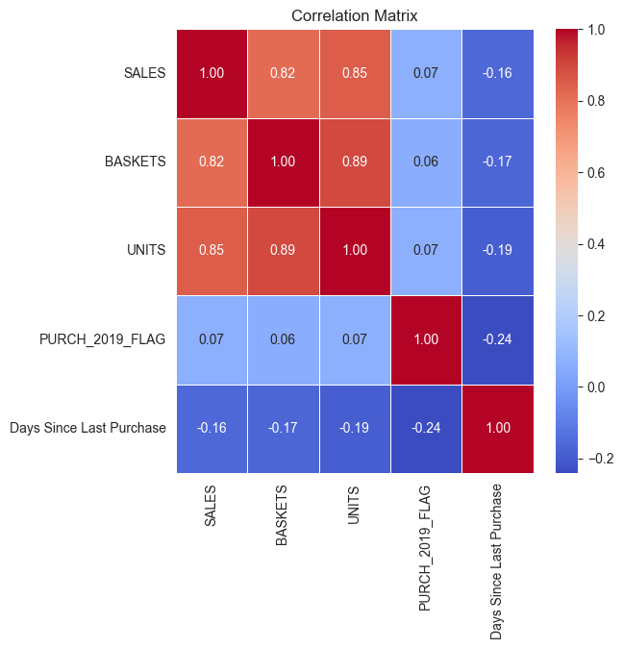
Key Data Insights
Correlation Analysis:
Strong positive correlation among Baskets, Units, and Sales.
Weak negative correlation between Days Since Last Purchase and other variables.
Skewness:
Metrics were right-skewed, indicating clustering around smaller values with some extreme outliers.
Applied log transformation to normalize the data distribution.
Learn More

Slide 5
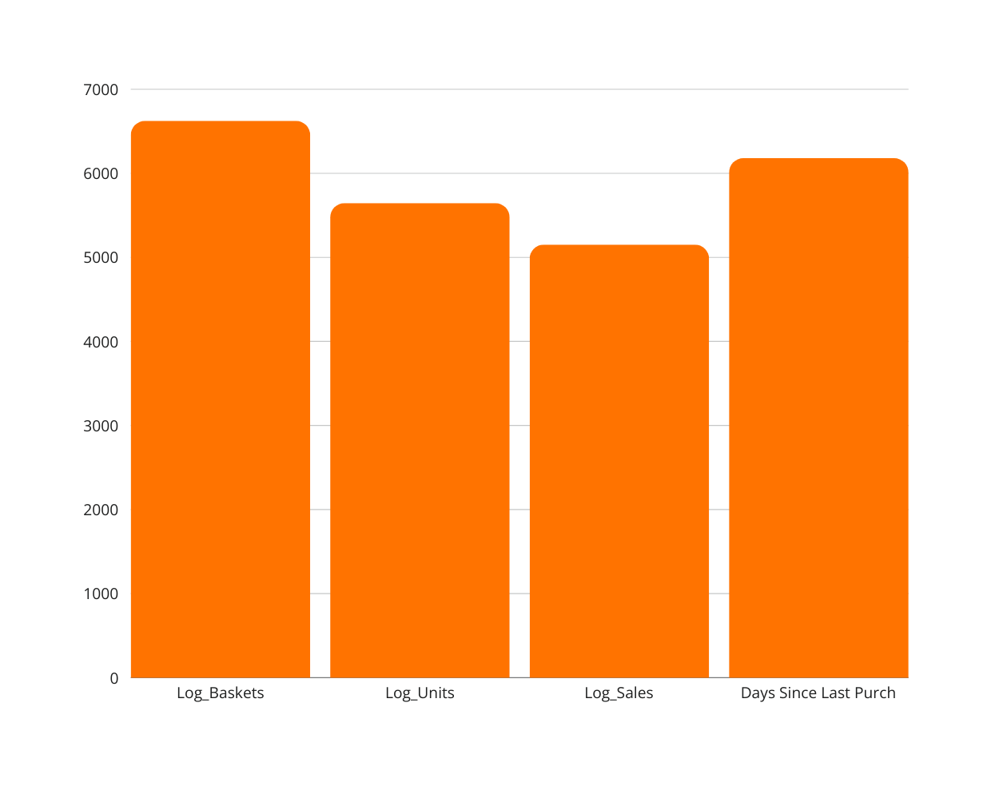
One-Way ANOVA Results
F statistic For variables
ANOVA test results for the impact of features on attrition:
All features showed significant variance between retained and attrited customers.
P-value: 0 (indicating strong statistical significance).

Slide 6
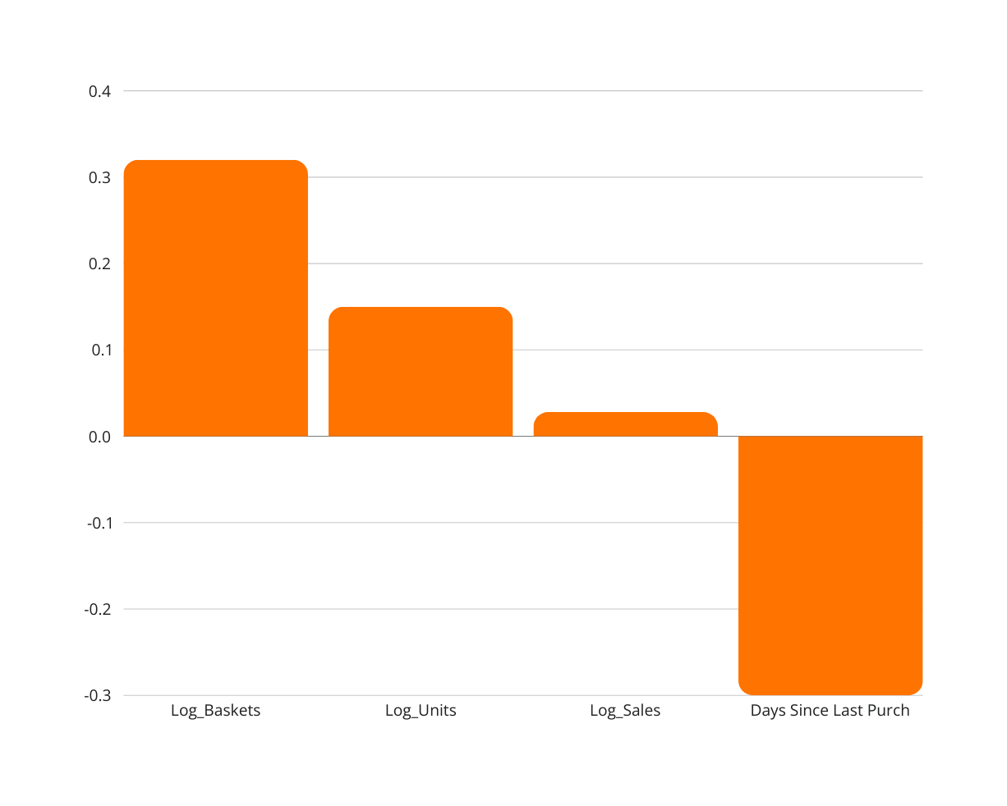
Feature Predictive Power (Logistic Regression)
Coefficients
Logistic Regression was used to measure the predictive power of each variable.
Log_Baskets is the strongest positive predictor.
Days Since Last Purchase negatively impacts retention

Slide 7
Key Insights and Recommendations
Insights:
Most Predictive Features:
Number of baskets and days since the last purchase.
Customers with more baskets and fewer days since last purchase are less likely to churn.
Weaker Predictors: Sales and units, though still relevant.
Actionable Steps:
Engage customers with low basket counts using personalized promotions.
Target customers with high "days since last purchase" through reactivation campaign

Slide 8
Techniques to Address Attrition
Techniques:
Logistic Regression: To predict probability of attrition.
Decision Trees/Random Forests: For capturing complex feature interactions.
Clustering : To segment customers by behavior.
Feature Selection:
ANOVA - to check statistical signficance of variability, Logistic Regression - to check predictive power of variables
Correlation analysis - check strength of relationship between variables

Slide 9

THANK YOU

